Slide 1
Towards the 2025 SNA
The Update of the 2008 SNA: Impact on the Measurement of Services
Peter van de Ven
Lead Editor of the Update of the 2008 SNA
39th Meeting of the Voorburg Group on Service Statistics
Copenhagen, 22 – 26 September 2025

Slide 2
A short reminder
Why an update of the 2008 SNA (and BPM6)?
Major shifts in the global economy
  Global financial crisis highlighted data shortcomings
  Digitalization, financial innovation, globalization
  Increasing demand for data to address issues of well-being and sustainability
The conceptual frameworks designed to be robust and resilient
  However, shortcomings in analytical usefulness exposed
  Digitalization and globalization posed new challenges to data compilation
Respond to identified data needs
  G20 Data Gaps Initiative
  Stiglitz-Sen-Fitoussi Commission

Slide 3
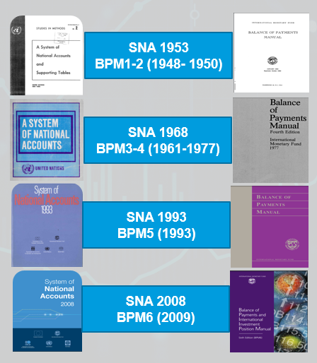
A short reminder
Conceptual updates (what is measured)
Methodological updates (how activities are measured)
Presentational updates (how statistics are presented)
More and more attention to arrive at consistency with other standards (e.g., SEEA, GFSM and MFSMCG)

Slide 4
Short recap of the process
In 2020 UNSC requested the Inter-Secretariat Working Group on National Accounts (ISWGNA) to submit, for consideration by the Commission at its fifty-second session in 2021, a road map for the revision of SNA for adoption by the Commission in 2025
Subsequently, the IMF Committee of Experts on Balance of Payments Statistics (BOPCOM) decided to launch a parallel process for updating the BPM6 with a target release date of March 2025
The 2021 UNSC meeting endorsed the work programme for the update of the 2008 SNA
In early 2022, the Project Manager (Pete Harper) and Lead Editor (Peter van de Ven) commenced work. They are supported by a five-person editorial team.
The update of the SNA is overseen by the ISWGNA, assisted by the Advisory Expert Group (AEG) on National Accounts

Slide 5
Short recap of the process
65 Guidance Notes were prepared by 10 Task Teams that had been set up to undertake the research phase of the SNA Update (some of these Task Teams were joint SNA/BPM task teams)
Priority areas:
  Globalization
  Digitalization
  Well-being and sustainability

Slide 6

Guidance notes – Globalization
    G.1: Valuation of imports and exports
    G.2: Treatment of MNE and intra-MNE flows
    G.3: Transfer pricing within MNE group (combined with GN G.5)
    G.4: Treatment of Special Purpose Entities and residency
    G.5: Economic ownership and recording of intellectual property products
    G.6: Merchanting and factory-less goods producers and recording of their transactions (combined with GN C.4)
    G.7: Global value chains and trade in value-added
    G.8: Typology of global production arrangements (combined with C.4)
    G.9: Payments for “knowledge-based capital”
Ireland’s Economists Left Speechless by 26% Growth Figure (Bloomberg)
Why GDP growth of 26% a year is mad (Economist)
It’s complete bullshit, it’s Alice in Wonderland economics (Colm McCarthy, University College Dublin)

Slide 7




Guidance notes – Digitalization
    DZ.1: Price and volume measurement of goods and services affected by digitalization
    DZ.2: Crypto assets (combined with GN F.18)
    DZ.3: Clarifications to the existing SNA treatment of “free” products
    DZ.4: Recording and valuing “free” products in an SNA satellite account
    DZ.5: Digital supply and use tables
    DZ.6: Recording of data in the national accounts
    DZ.7: Artificial Intelligence
    DZ.8: Cloud computing
    DZ.9: Digital intermediary platforms
    DZ.10: Non-fungible tokens

Slide 8



Guidance notes – Well-being and Sustainability
    WS.1: Broader framework
    WS.2: Distribution of household income, consumption, saving and wealth
    WS.3: Unpaid household service work
    WS.4: Labour, education and human capital
    WS.5: Health and social conditions
    WS.6: Economic ownership and depletion of natural resources:
    WS.7: Emission permits: the atmosphere as an asset
    WS.8: Accounting for biological resources
    WS.9: Recording of provisions
    WS.10: Valuation methods
    WS.11: Renewable energy resources
    WS.12: SEEA classifications
    WS.13: Recording of losses (dropped)
    WS.14: Distinction between taxes and services

Slide 9
Guidance notes – Other issues
    Communications Task Team (CMTT):
      Alignment of terminology on type of statistical releases and updates, different types of tables and accounts
      More user-friendly terms and definitions
      Assessing alignment to international standards
    Financial Issues Task Team (FITT):
      Non-bank financial intermediation (“shadow banking”)
      Rather specific recommendations on financial services and instruments (financial derivatives, reverse transactions, factoring, cash collateral)
      Valuation of financial instruments
    Islamic Finance Task Team (IFTT)
    Informal Economy Task Team (IETT)
    Various issues related to balance of payments, some of which interrelated with above issues

Slide 10
Short recap of the process
Each GN was initially reviewed by AEG (and BOPCOM where relevant) and then underwent global consultation
Following the incorporation of feedback from the global consultation, the GNs were endorsed by AEG/BOPCOM
In addition, various other Issues Notes addressing items on the 2008 SNA research agenda were prepared by the editorial team (often in conjunction with BPM editorial team) and discussed by the AEG
From this, a consolidated list of changes was prepared
The consolidated list of changes was subject to global consultation in August 2023
In February 2024, the UNSC endorsed all proposals except treating marketing assets as produced assets
The UNSC highlighted the need to develop compilation guidance for changes that have a significant impact and/or require significant effort to implement

Slide 11
Finalising the 2025 SNA
Starting on the 17th of June 2024, the complete draft of the 2025 SNA was circulated for global consultation, with the 13th of September 2024 as the end date for feedback
Two types of chapters
  The chapters that are new or substantially revised were shown in “track changes” compared to the versions previously circulated for global consultation (based on agreed annotated outlines)
  The chapters that are not new or substantially revised were shown in “track changes” compared to the equivalent SNA 2008 chapter
Sign-off on the updated 2025 SNA by the AEG/ISWGNA: end of October 2024
On the 4th of March 2025, the UNSC endorsed the 2025 SNA
1,200+ pages white cover version, still subject to final editing, released immediately after the UNSC-meeting; see https://unstats.un.org/unsd/nationalaccount/docs/2025_SNA_Pre-edit.pdf.

Slide 12
Key relationships
Close relationships with the BPM update team
The Regional Commissions are playing a valuable role in outreach
GFS, MFS and SEEA communities have been closely involved in the update process as appropriate
The ILO has been involved in the drafting and review of chapter 16 (Labour) and the review of chapters 34 (Measuring Wellbeing) and 30 (Informal economy)
The UNSD (Time Use) has been involved in the drafting and review of chapter 34 (Measuring Wellbeing)
The ISIC and CPC update programs have considered SNA update issues as part of their review processes
There is coordination between the SNA 2025 update and the G20 Data Gaps Initiative (DGI)

Slide 13
Impact on service statistics: general introduction
Changes to the 2008 SNA in relation to the measurement of services:
Change in measurement of non-market services
New guidance on digital services
  Cloud computing
  Data
  Artificial intelligence
  Digital platform services
  Crypto assets
Changes in guidance on financial services:
  Central bank services
  Implicit financial services on loans and deposits (formerly known as FISIM)
  Factoring services
  Investment fund and asset management services
  Insurance and pension fund services
  Islamic finance (new chapter 26) => Not further discussed in detail

Slide 14
Impact on service statistics: general introduction
Changes to the 2008 SNA in relation to the measurement of services:
Other issues related to the measurement of services
  Treatment of travel packages and health-related travel
  Treatment of stability fees
  Distinction between taxes and services
  Rerouting of transactions through government
More detailed guidance on volume and price measurement
NB: Household production of electricity (solar panels and wind power plants) and production of heat (geothermal heat or heat pumps)

Slide 15
Change in measurement of non-market services
A more consistent application of the sum of costs method
No market prices available for non-market services, such as those provided by government
Value of non-market services approximated by the sum of costs; according to 2008 SNA:
  Intermediate consumption
  Remuneration of employees
  Other taxes (less subsidies) on production
  Depreciation of fixed capital
Different from the method applied for own-account production by market producers

Slide 16
Change in measurement of non-market services
A more consistent application of the sum of costs method
Two cost elements made more generic for market and non-market:
  Depreciation (and depletion where relevant) related to capital used in production; however, depletion is considered to be hardly relevant
  Net return to capital, not only fixed capital
One cost element added for market and non-market:
  Rent payable on the use of (rented) non-produced non-financial assets
In addition, one cost element added for non-market producers:
  Net return to capital used in production
    Agreement that net return to capital for city parks and historical monuments excluded, on pragmatic grounds
    Some discussion on whether nominal or real rate of return should be used
    Some discussion on whether or not a net return to capital should also be applied to certain parts of land

Slide 17
New guidance on digital services: cloud computing products
Infrastructure-as-a-service (IaaS), which gives the user on-demand access to hardware such as a virtual server
Platform-as-a-service (PaaS), which also includes access to a software platform
Software-as-a-service (SaaS), which includes access to the application software
Users of IaaS or PaaS provide their own software license, or software original
Function-as-a-service (FaaS) is a simplified type of PaaS that allows application functionalities to be executed in response to events
Business-process-as-a-service (BPaaS) enables organizations to automate business processes using cloud computing software and platforms (i.e., SaaS and PaaS)

Slide 18
New guidance on digital services: cloud computing services
Cloud computing is part of a broader shift to remote computing that also includes the growth of co-location and hosting services
Remote data centres can offer advantages such as physical infrastructure that supports large-scale computing, high network bandwidth and optimized connectivity, low cost, and security
To benefit from such advantages, IT users may lease space for their equipment in a colocation datacentre, or they may lease servers and other ICT equipment from a supplier of managed or unmanaged hosting services
IT users often consume a combination of the three types of remote computing services – for example, their co-located or hosted equipment may connect with a supplier of cloud computing service

Slide 19
New guidance on digital services: cloud computing services
Cloud computing users with a long-term contract for dedicated access to a server in a cloud computing data centre are considered to be economic owners of the server if the operating risk is borne by the user, making the contract a financial lease
Cloud computing users may also hold long-term licenses for a software product that they access in the cloud; if the term of the software license is more than a year, the license conceptually represents a software asset of the user
One-year software licenses that automatically renew are also treated on the same lines, for practical reasons

Slide 20
New guidance on digital services: cloud computing services
Cloud computing services often supplied across borders
If a business in country A purchases computing services from a cloud computing establishment in country B, the computing services are to be recorded as an export of country B and an import of country A
The resource pooling aspect of cloud computing technology means that workloads can shift between servers or even establishments, and make it hard to determine the physical place of production
However, the payment flows on cloud computing should be more feasible to track
Hosting and co-location services are exported when foreign-owned IT assets, such as servers and software, are hosted in a resident data centre; similarly, these services are imported when locally owned ICT assets are hosted in a non-resident data centre

Slide 21
New guidance on digital services: data
Data: Information content that is produced by accessing and observing phenomena, and recording and storing information elements from these phenomena in a digital format, which provide an economic benefit when used in productive activities
Data as an asset is data used in production for more than one year; shorter-lived data to be treated as intermediate consumption
Data is produced when information on observable phenomena such as facts, behaviours, and characteristics is recorded and stored in digital format; in a next step, databases are created by structuring and organizing the data to enable efficient retrieval and analysis
Often difficult to disentangle from databases, and therefore combined
Typically produced in-house, and measured at the cost of production

Slide 22
New guidance on digital services: data
Payments for access to data collection on an individual’s observable phenomena are classified as rent
Being the subject of the data collection is not to be considered equivalent to supplying a service, but as a payment for the permission to access observable phenomena
However, users who receive payments for undertaking specific actions to assist the collection and recording of data on their observable phenomena do supply a service, but such cases are likely to be too rare in practice to be worth distinguishing

Slide 23
New guidance on digital services: artificial intelligence
Artificial intelligence refers to capabilities of a computer program, or system controlled by a computer program, of recognition, reasoning, communication, and prediction emulating human recognition, reasoning, and communication
To be distinguished as a special type of software within a class of intellectual property products identified as “computer software, including artificial intelligence systems”, with the separate reporting of artificial intelligence encouraged as an “of which” item
The value of the data used to train an artificial intelligence software product or to help artificial intelligence software to generate its output should be recorded separately from the value of artificial intelligence software, as the data could have multiple uses

Slide 24
New guidance on digital services: digital platforms
Four types of digital platforms distinguished:
Non-financial digital intermediation platforms: facilitate transactions between multiple buyers and multiple sellers for the ordering and delivery of goods and services for a fee or commission without taking ownership of the goods or rendering the services that are being sold (intermediated)
Free online platforms: facilitate non-commercial interactions between users or provide entertainment and information services and are usually funded by advertising and the collection of data on their users
Financial digital platforms: intermediate for funding or payment transactions for a fee
Other fee-based digital platforms: facilitate interactions between users other than transactions in goods, non-produced non-financial assets and services or financial transactions, e.g., online dating and matrimonial platforms

Slide 25
New guidance on digital services: digital platforms
Non-financial digital intermediation platforms:
May also facilitate ordering, payment for, and delivery of, goods and services supplied, and also provide quality assurance through steps such as vetting the parties that have access to the platform
Output consists of digital intermediation services, which may be charged via an explicit or an implicit fee; it does not include the goods and services that the digital intermediation platform helps others to sell
The seller/producer and the buyer/consumer both consume intermediation services in the case they are separately invoiced for the services supplied by the platform
In the case where all fees are invoiced to the seller/producer, only the seller/producer is recorded as consuming the intermediation services, and similarly, only the buyer is recorded as consuming the intermediation services in the case where all fees are invoiced to the buyer

Slide 26
New guidance on digital services: digital platforms
Non-financial digital intermediation platforms:
Platforms often accept buyers’ payments for the goods and services produced or sold, and pass through the amount to the producer/seller after deducting their intermediation service fee
To capture the economic substance of these transactions, the payment flows must be rerouted to include (i) a sale of good or service by the producer/seller to the buyer, and (ii) a purchase by the producer/seller of the intermediation services supplied by the platform (“producer’s approach”)
In some cases, platforms seek to attract buyers to the platform by using a portion of the fees to pay rebates to buyers => a reduction in the price of the goods and services, and are thus not part of the fee (or price) that the platform retains for its intermediation services

Slide 27
New guidance on digital services: digital platforms
Free digital platforms and free digital products:
Free products supplied by market producers are generally valued at zero
The relevant platforms typically produce advertising services (or earn income from licensing or selling data), which are included in GDP as part of the price of other products they help sell or with which they are bundled either directly or indirectly
Taken together, the items in the bundle generate at least enough revenue to cover the operating costs of the supplier of the free product, so the overall output of the supplier of the free digital product is not undermeasured
Free products may also be supplied by non-platform enterprises, e.g., as part of a “freemium” pricing strategy (i.e., free basic version, promoting sales of upgrades or a premium version of the product)

Slide 28
New guidance on digital services: digital platforms
Free digital platforms and free digital products:
A few free online platforms (such as public wikis created and maintained by communities of volunteers) are owned by a non-profit institution serving households
They operate as non-market producers, whose output is valued by the costs of production
Nevertheless, the production costs of these platforms may be modest in comparison with physical indicators of its output such as number of visits or scale of content it hosts, because volunteers may do much of the work
The work of volunteers in producing services is outside the production boundary of the integrated framework of the SNA

Slide 29
New guidance on digital services: digital platforms
Free digital platforms and free digital products:
Many users of free platforms create content such as videos, images, text, and audio, both as a leisure activity and for commercial purposes such as receiving advertising revenue
Creating content for leisure purposes is outside the production boundary of the SNA; if the content creator does not receive remuneration, the content is assumed to be created for leisure purposes
Households that receive monetary remuneration from an advertiser or platform for use of their uploaded content are considered unincorporated household enterprises supplying services to the advertiser or platform
In addition to posting content on free platforms that receive advertising revenue, content creators may publish on digital platforms that collect subscription fees on their behalf in return for a share of the fees

Slide 30
New guidance on digital services: digital platforms
Free digital platforms and free digital products:
The value of the free services that free digital platforms funded by advertising or data is relevant for analytical purposes and for understanding the broader impact on household final consumption of the emergence of these free platforms
Alternative measures of household final consumption expenditures and the output of free online platforms that include the households’ direct consumption of the (free) services provided by platforms may be presented in an extended account on free online platforms
More details on such an extended accounts are provided in section F of chapter 22 of the 2025 SNA
The effect of free platforms and free digital products on volume growth of household consumption is also conceptually relevant for understanding the impact of digitalization on prices and volumes
Free digital products and the measurement of prices and volumes are discussed in more detail in section E of chapter 22 of the 2025 SNA

Slide 31
New guidance on digital services: digital platforms
Financial digital platforms:
Provide matching services and facilitate financial transactions between suppliers of funds and users of funds
They do not take ownership of the financial assets arising from claims on the users of funds or incur liabilities to the suppliers of funds
They receive fees or commissions for their services and are classified as financial auxiliaries
Four different types can be distinguished:
  peer-to-peer and other online lending platforms
  equity-based crowdfunding platforms
  philanthropic (or donation-based) crowdfunding platforms
  reward-based crowdfunding, in which the donors to a project expect to receive a non-financial reward such as a good or service

Slide 32
New guidance on digital services: digital platforms
Financial digital platforms:
A special type of financial digital platform whose main purpose is not to facilitate access to funding consists of crypto asset exchanges and trading/lending platforms
These allow users to buy, sell and lend crypto assets for a fee or commission
They typically embed their fees into their buying and selling prices
Fees received from staking of crypto assets are treated as payments for the provision of non-financial services
Some crypto exchanges may (also) provide custodian services and hold crypto assets of customers for a fee

Slide 33
New guidance on digital services: crypto assets
Crypto assets: Digital representations of value that use cryptography and distributed ledger technology (DLT) such as blockchains to enable parties to transact directly with each other without the need for a trusted intermediary
DLTs allow transactions to be recorded, synchronized, and shared simultaneously on multiple nodes in a decentralized network; blockchains create cryptographic records of transactions and ownership that are impossible to alter without detection
Crypto assets are classified as either fungible or non-fungible
  Fungible crypto assets are divisible and not unique (e.g., one bitcoin is equal to any other bitcoin and can be divided into equal pieces of similar value)
  Non-fungible crypto assets, commonly known as non-fungible tokens (NFTs), are unique and non-divisible

Slide 34
New guidance on digital services: crypto assets
Fungible crypto assets are classified into three broad categories:
  Those designed to act as a general medium of exchange (which are further divided in those with, and those without, a corresponding liability)
  Those designed to act as a medium of exchange within a platform or network—also known as payment tokens (again divided into those with, and those without, a corresponding liability)
  Security crypto assets
Decision tree available in figure 22.2 of the 2025 SNA
Crypto assets with a corresponding liability are generally classified as financial instruments
However, crypto assets without a corresponding liability are classified as non-produced non-financial assets
If a crypto asset without a corresponding liability is ever able to gain widespread acceptance as a general medium of exchange, the guidance on its classification may be re-considered

Slide 35
New guidance on digital services: crypto assets
Major discussion on the classification of crypto assets without a corresponding liability designed to act as a general medium of exchange: financial asset or non-financial asset; and – if non-financial asset – produced or non-produced asset
The “mining” of crypto assets without a corresponding liability is to be looked upon as validating crypto asset transactions, and to be treated as production of services
The process may include the release of new units of the crypto asset as an implicit fee paid to the miner validating the transaction; the miner may also receive an explicit fee in crypto assets paid by the party initiating the transaction, which is normally the sender/seller
The validation services that are rewarded with newly released units of the crypto asset are assumed to be collectively consumed by the existing holders of that crypto asset, while those rewarded by the explicit fee are consumed by the transactor paying the fee (normally the sender/seller)

Slide 36
Changes in guidance on financial services: central bank
2008 SNA:
  Three types of services distinguished: (i) monetary policy services (always non-market); (ii) supervisory services; and (iii) implicit financial services on loans and deposits (always market)
  Supervisory services either market or non-market based on whether fees are charged that are sufficient to cover the costs
  Non-market services recorded as being delivered to government, and thus adding to government output
2025 SNA:
  No implicit financial services on loans and deposits
  Other services broadened to monetary policy services, including by issuing currency and regulating money supply; services related to promoting financial stability, including regulation and macroprudential supervision; services related to managing international reserves and the payments systems; and acting as banker to government
  Always considered as non-market services, produced and consumed by the central bank

Slide 37
Changes in guidance on financial services: implicit financial services on loans and deposits
Basic approach:
  (rL – rr) * value of loans
  (rr – rD) * value of deposits
A single reference rate to be used (thus avoiding the exclusion of liquidity transformation):
  based on a single observable exogenous rate for a specific instrument, such as interbank lending rates
  based on a weighted average of observable exogenous rates of maturities with different terms (weighted by the stock of loans and deposits in each maturity)
  a weighted average of the endogenous interest rates on loans and deposits
Special attention during periods of volatile interest movements, and/or dis-functioning liquidity markets
Conceptual merit in excluding credit default risk
International trade: distinction of at least two currencies

Slide 38
Changes in guidance on financial services: factoring
Factoring: Transaction in which a financial corporation buys trade accounts receivable from a supplier of goods and services at a discount
Two basic types:
  Non-recourse: the factor assumes the full risk of non-payment by the debtors at maturity (higher fee)
  Recourse: part of the risk is kept by the supplier
Discount is equal to the difference between the nominal value of the accounts receivable and the actual payments by the factor to the supplier, and may consist of three elements:
  Fees
  Interest
  Compensation for possible credit defaults

Slide 39
Changes in guidance on financial services: factoring
In normal circumstances (short-term financing with low amounts of interest and credit default), discount may provide a good approximation of output of services
In other circumstances, a value for risk-free interest and credit default risk should be estimated, or alternatively, a sum of costs method should be applied
By the way: no implicit financial services on loans and deposits to be assumed

Slide 40
Changes in guidance on financial services: investment fund and asset management services
Units may be set up to hold and manage assets on behalf of other units: mutual funds, holding companies, trusts, SPEs, and the like
Incur administrative expenses such as payments to fund managers, custodians, banks, accountants, lawyers, or their own staff
Explicit fees may be charged, or implicitly paid out of the investment income
Alternatively, output could be measured at sum of costs

Slide 41
Changes in guidance on financial services: investment fund and asset management services
In the case of most investment funds, the funds typically pay fees to service providers to support the funds operations (buying and selling of securities, providing legal, accounting, etc.)
In turn, a service fee is charged to investors (equivalent to the amount of operating expenses, usually reported as an annual percentage of the assets in the fund)
In addition, holders of investment fund shares/units may be charged with fees on specific transactions (e.g., redemption fees, exchange fees for transferring shares/units within the same fund group or account fees)
Importantly, both types of fees are treated as financial services that are provided directly from the original professional providers to the shareholders
The same holds for any implicit financial services on loans and deposits

Slide 42
Changes in guidance on financial services: insurance and pension services
Output of insurance is typically measured as follows: actual earned premiums + premium supplements – claims/benefits (– change in life insurance and annuity entitlements)
Similar treatment may be applied to pensions
Premium supplements equal returns on investment of technical reserves
Measurement of these supplements often gives rise to confusion, especially regarding the inclusion or exclusion of holding gains/losses
2025 SNA provides more clarity

Slide 43
Changes in guidance on financial services: insurance and pension services
Non-life insurance (and reinsurance): actual property income on investments of insurance technical reserves, excluding holding gains and losses;
Life insurance: all income allocated to the life insurance policyholders to be recorded as property income, whether or not this income originates from property income or from holding gains (or losses)
Defined contribution pension schemes: investment income excludes any holding gains and losses
Defined benefit pension schemes: investment income equal to that allocated to the pension entitlements (i.e., unwinding of the pension entitlements using the discount factor), disregarding the source of the income
Autonomous multi-employer pension schemes: sum of costs method

Slide 44
Other issues related to the measurement of services
Treatment of travel packages and health-related travel
Various services contained in these packages are to be unbundled
The same holds for taxes and fees part of passenger tickets
Treatment of stability fees
Example: payments for deposit insurance schemes
To be classified as either a tax or as a payment for an insurance-type of transaction
Criterion: Proportionality between payments and the provision of an insurance-type of service (including payments for the risk element)
The existence of a fund functioning on insurance rules with a full set of accounts may indicate proportionality, while payments not being put aside or being able to be used for other purposes, may be indicative for treating the payments as a tax

Slide 45
Other issues related to the measurement of services
Distinction between taxes and services for licenses etc.
2008 SNA: If the government uses the issue of licences to exercise some proper regulatory function (checking the competence of the person concerned, checking the efficient and safe functioning of the equipment, or carrying out some other form of control), the payments should be treated as purchases of services from government, unless the payments are clearly out of all proportion to the costs of providing the services
2025 SNA: Payments for licenses required under a mandatory process are generally considered as being unrequited, and thus to be recorded as taxes
However, for cases where the 2008 SNA conceptual guidance for distinguishing between taxes and services is considered more appropriate, clarification on its application in practice is provided

Slide 46
Other issues related to the measurement of services
Rerouting of transaction through government
New guidance on the rerouting of transactions through government
Scenarios where transactions between two (or more) non-government actors are to be rearranged through the government accounts include:
  Government replaces a pre-existing scheme involving payments to and from government with a new scheme under which the payments, which provide a similar economic outcome, are made directly and not through government
  Government mandates cash payments between economic actors that would not take place without the government intervention
  Government instigates a price cap, or price fix, but has a mechanism to fund the difference between the price cap and the market price (or another price), perhaps at a future date

Slide 47
More detailed guidance on volume and price measurement
More detailed guidance on volume and price measurement of services; however, all of this concisely, focusing on main principles
Non-market output:
  Output volume method (quantity indicators, adequately quality-adjusted, weighted together using average cost weights), especially for individual services (health, education, etc.)
  For collective services, default method is deflation of inputs, possibly adjusted for change in productivity

Slide 48
More detailed guidance on volume and price measurement
More detailed guidance on the volume and price measurement of specific goods and services provided in chapter 18 of the 2025 SNA
  Digital goods and services (with more details in section E of chapter 22)
  Passenger transport
  Output of the central bank
  Implicit financial services on loans and deposits
  Services of owner-occupied dwellings
  Education services
  Health services

Slide 49
In summary
A lot of detail has been added in the 2025 SNA; more than can be properly addressed in this presentation
Interested? Please have a closer look at the relevant parts of the 2025 SNA
Questions: pjm.vandeven@outlook.com

Slide 50


Thank you for your attention!

Slide 51
Main conceptual changes
Annex: Main changes to the 2008 SNA
(not to be included in the presentation)

Slide 52
Main conceptual changes
There are only a limited number of conceptual changes affecting key macro-economic indicators, such as GDP/NDP, government deficit, and net worth
Recognition of data as produced assets
Recognition of marketing assets as produced assets NOT AGREED AT 2024 UNSC
Recording depletion of natural resources as a cost of production
Improving consistency in the application of the sum-of-costs method, by including a return to capital in all cases, also for non-market producers
Changes in the measurement of the output of central banks, by treating all central bank output as non-market output, to be recorded as final consumption expenditure of the central banks

Slide 53
Other conceptual changes
Treatment of dividends for FDI-enterprises: can now be paid out of previous periods’ profits
Extension of the definition of rent (i.e., payments to the owner for putting certain non-produced assets at the disposal of another unit), by including non-produced non-financial assets other than natural resources
Recording of work-in-progress for fixed assets partially transferred and for fixed assets produced for own final use
Limitation of concessional loans to those provided by employers to employees
All equity in international organizations to be considered as “other equity”
Securities provided as collateral by central banks, which are not readily available for meeting balance of payments financing needs, to be excluded from the cash borrower’s reserve assets; for gold swaps, this reclassification leads to a demonetization of the gold bullion

Slide 54
Inclusion of new statistics
A distinction can be made between the following tables and data items:
  Integrated framework of national accounts: standard set of accounts and tables, the compilation of which is recommended
  Supplementary tables/items
  Extended/thematic accounts/tables
The SNA does not have the power of law, but one of the main factors for the success of the SNA is the worldwide compilation of statistics according to its conceptual guidance
The objective is that as many countries as possible compile the integrated framework of national accounts
Other tables and accounts more dependent on national and regional priorities

Slide 55
Accounting for globalization
To arrive at a better understanding of the impact of globalization on the generation and distribution of income, and also to arrive at an improved international comparison of fiscal balances, standard breakdowns of corporations into:
  Foreign-controlled corporations
  Public corporations
    Of which: Part of domestic MNEs
  National private corporations
    Of which: Part of domestic MNEs
In addition, various supplementary items and tables are encouraged:
  Extended supply and use tables (eSUTs)
  Data on Special Purpose Entities (SPEs) for those countries where these entities are important

Slide 56
Accounting for digitalization
To improve the visibility of the digital economy:
  More detailed breakdowns of certain asset categories within intellectual property products, in the integrated framework of national accounts
  In addition, digital supply and use tables are encouraged as extended/thematic tables, also including extended accounting for “free” services (Facebook, Instagram, TikTok, etc.)
  Further breakdowns of subsectors of financial corporations of fintech-related activities, as supplementary items in countries where these activities are significant
  Standard breakdown, under non-produced non-financial assets, for crypto assets without a corresponding liability designed as a medium of exchange and non-fungible tokens

Slide 57
Accounting for financial risks and vulnerabilities
Since the Great Financial Crisis, it is considered important to arrive at an improved accounting for financial risks and vulnerabilities:
  Non-bank financial intermediation (shadow banking): supplementary tables with more detailed breakdowns of financial corporations, as well as additional details for certain financial instruments
  Breakdowns of financial derivatives
  From-whom-to-whom tables (supplementary) (not included in the consolidated list)

Slide 58
Other supplementary items and tables
Concessional loans: supplementary data on concessional loans provided by government and international organizations
Reinvested earnings:
  Breakdown of FDI-related dividends into payments as defined for non-FDI corporations and other payments
  Supplementary data on recording reinvested earnings for all equity in corporations, direct investment as well as portfolio investment
Valuation of debt securities at both market value and nominal value for liability positions
Supplementary table on provisions, broken down into three categories: financial assets related, non-financial assets related, and provisions unrelated to assets

Slide 59
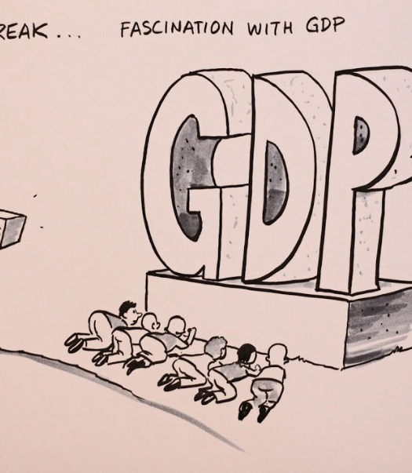
Accounting for well-being and sustainability
Lots of criticism on GDP in providing adequate guidance for policy:
  Does not appropriately measure well-being (including its distribution), or progress of society more generally
  Does not address environmental issues and ecological boundaries
GDP ≠ (sustainable) well-being
GDP ≈ measure of economic activity
A promising all-encompassing summary indicator for well-being and sustainability, which can meet minimum levels of scrutiny, has not yet been developed
Best alternative for capturing well-being: dashboard of indicators addressing different aspects of well-being (and sustainability), such as OECD Better Life Index and UN SDGs
In the case of monitoring sustainability: broadening the measures of capital

Slide 60

Monitoring well-being (and sustainability)
Starting point: well-being is a multidimensional phenomenon
One single measure not feasible
OECD Better Life Index, various dimensions:
  Housing
  Income
  Jobs
  Education
  Civic engagement
  Health
  Life satisfaction
  Safety
  Work-life balance, etc.

Slide 61
A response from national accounts
Clear distinction made between:
What can be done within the integrated framework of national accounts
What can be done when going beyond the integrated framework of national accounts, by establishing a broader framework of accounts, which …
  … addresses certain aspects of well-being and sustainability
  … can support the analysis of broader measures of well-being and sustainability

Slide 62



Accounting for sustainability (within the integrated framework of national accounts)
Recording depletion of natural resources as a cost of production
Split-asset approach for natural resources => value of asset to be shared between owner and extractor based on shares of resource rent
Recognition of renewable energy resources
Adjustments in the treatment of biological resources
Natural capital as a separate category, including both produced and non-produced assets
More detailed breakdowns of non-financial assets and financial assets, including for emission permits (to be treated as financial assets with taxes on production recorded at surrender, valued at issuance value)
Focus on improving the estimation of natural resources

Slide 63
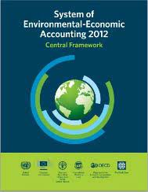

Accounting for sustainability (beyond the integrated framework of national accounts)
To arrive at an improved accounting of (environmental) sustainability, SEEA Central Framework 2012 and SEEA Ecosystem Accounting recognized as important frameworks which are complementary to and consistent with the SNA

Slide 64
Accounting for sustainability (beyond the integrated framework of national accounts)
Supplementary data on Green and ESG Finance
Much more emphasis on more encompassing (monetary) measures of capital:
  Economic capital (as included in the integrated framework of national accounts)
  Natural capital (further extension to ecosystem assets and physical measures, in line with SEEA)
  Human capital (provision of provisional guidance on measurement)
  Social capital (difficult to capture)
Implicitly assumes perfect substitution, while critical levels of especially environmental capital may/do exist
Monetary measures don’t tell the whole story, need to be supplemented by physical measures, which may be much more important in monitoring sustainability

Slide 65
Developing practical guidance
The compilation of natural capital estimates can be challenging
An Expert Group on Natural Capital was established in 2023 to develop practical guidance to assist countries in compiling the relevant estimates
The group has been discussing data sources, compilation techniques and the use of specific assumptions
The group consists of experts from statistical offices and international organisations, covering NA, GFS and SEEA
The draft handbook ”Measuring natural capital in the national accounts: a compilation guide” will become available in 2025

Slide 66
Accounting for well-being (within the integrated framework of national accounts)
Very valid recommendations made in the Stiglitz-Sen-Fitoussi Report, in respect of macro-economic statistics, by putting people at the centre:
When evaluating material well-being, look at income and consumption rather than production
Emphasise the household perspective
Consider income and consumption jointly with wealth
Give more prominence to the distribution of income, consumption and wealth
Broaden income measures to non-market activities

Slide 67
Accounting for well-being (within the integrated framework of national accounts)
More prominent use and dissemination of available indicators for the household sector: household (adjusted) disposable income, household final consumption, household wealth, etc.
Integrate distributional information for income, consumption, saving and wealth of households => standard breakdown of households by income and wealth decile
More detailed labour market tables
But also: put more emphasis on net measures, adjusted for depreciation and depletion

Slide 68
Accounting for well-being (beyond the integrated framework of national accounts)
Introducing other breakdowns of households (e.g., household composition, main source of income) are put forward as supplementary items
A broader set of accounts, with the primary objective of establishing a system of interconnected thematic and extended accounts, addressing certain aspects of well-being (and sustainability)
Pragmatic approach, based on existing international standards and guidance:
  Unpaid household activities: contribution of unpaid household work to GDP and economic well-being
  Education and training (and human capital): more details on labour inputs, the role of education, and the measurement of human capital
  Health and social conditions: more details on health outputs, including inputs for production

Slide 69
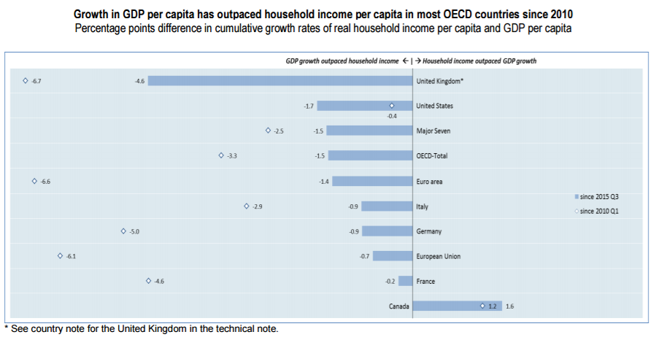
GDP growth versus real household adjusted disposable income

Slide 70
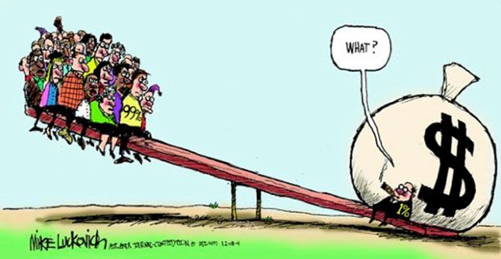
Distributional national accounts
Development of results for the complete sequence of accounts, capturing income, consumption and wealth
Unit of analysis is the household
Focus is on private households, as institutional households (e.g., people living in prison, boarding schools, nursing homes) behave differently and results are not comparable
Focus on equivalized results, i.e., taking into account different consumption needs of households of different size and composition, although still discussion for wealth
Household groupings:
  Standard breakdown: standard of living on basis of current income or wealth (quintiles/deciles/percentiles)
  Supplementary breakdowns:
    Main source of income
    Household type
    …

Slide 71
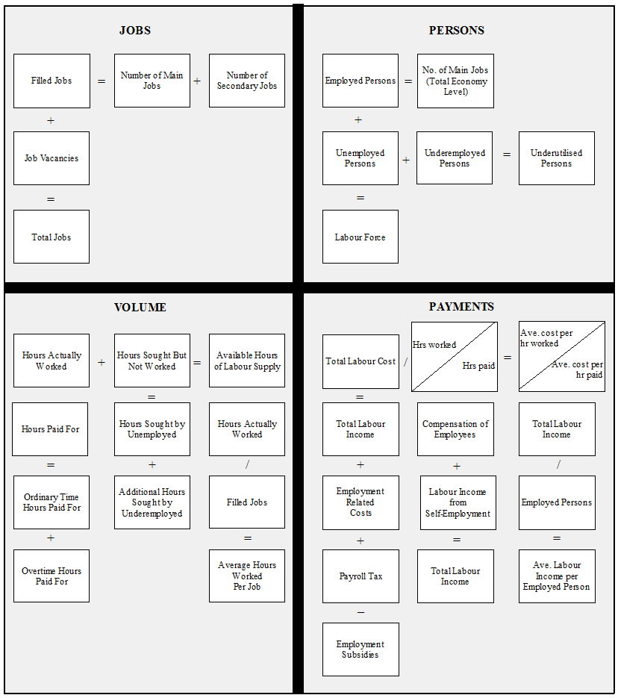



New labour tables

Slide 72



Unpaid household service work
Apply third-party criterion to include unpaid household service work
Proposal to distinguish the following categories:
  Unpaid childcare (including passive supervisory care)
  Adult care (including passive supervisory care)
  Nutrition
  Transport
  Household management services
  Laundry and clothing services
  Informal volunteering
  Shopping
  Information services
  Other unpaid household production not elsewhere classified
Input-approach should be adopted for valuation of unpaid work, using main activities recorded by a harmonized time-use survey
Specialist wage rates should be selected from market occupation

Slide 73

Education and human capital
Extended accounts on education and training, including monetary and non-monetary data:
  Breakdowns by purpose: Pre-primary education, primary education, secondary education, higher education, cultural, sport and recreation education, other education and vocational training, in-house training, and other education.
  Breakdowns by provider: Central government, state government, local government, NPISH, market producers in education, other market producers, and non-residents.
  Breakdowns by financing: Central government, state government, local government, NPISH, households, other institutional sectors, and exports.
Explore the development of experimental estimates for human capital, focusing on both cost-based and income-based measures

Slide 74


Health care
Extended supply and use tables for health care and long-term social care
  Breakdowns by function: curative care, rehabilitative care, long-term care, ancillary services, medical goods, preventive care, governance and health system and financing administration, and other health care services.
  Breakdowns by providers: hospitals, residential long-term care facilities, providers of ambulatory health care, providers of ancillary services, retailers and providers of medical goods, providers of preventive care, providers of health care system administration and financing, the rest of the economy, and the rest of the world.
  Breakdowns by financing: government schemes and compulsory contributory health care financing schemes, voluntary health care payment schemes, household out-of-pocket payments, and non-resident financing schemes.
Develop additional indicators to inform policy on health care, social care and well-being
Close alignment with System of Health Accounts (SHA)

Slide 75
Accounting for well-being (beyond the integrated framework of national accounts)
Main goal of the broader set of accounts: establishing a much better link between the macro-economic framework and the work on well-being and sustainability
Providing an improved information basis for analysing trade-offs and win-wins between various aspects of well-being and sustainability
Of special note:
  Dashboards often contain outcome-based indicators, while the broader framework is often limited to output-based indicators
  Output is instrumental to achieving certain outcomes
  Policy to improve outcomes runs via activities and related outputs

Slide 76
Beyond NA: a broader framework of accounts
Integrated framework of national accounts
Environmental-economic accounts (SEEA)
Household distributional accounts
Health accounts
Unpaid household activities
Labour accounts
Human capital

Slide 77
A Vision for the Future
“So, it has come to this. The global diversity crisis is so severe that brilliant scientists, political leaders, eco-warriors, and religious gurus can no longer save us from ourselves. The military are powerless, but there may be one last hope for life on earth: ……..…………..” (Jonathan Watts)

Slide 78
A Vision for the Future
“So, it has come to this. The global diversity crisis is so severe that brilliant scientists, political leaders, eco-warriors, and religious gurus can no longer save us from ourselves. The military are powerless, but there may be one last hope for life on earth: accountants” (Jonathan Watts)

